Slide 1
An Investigation of Homoclinic Orbits in the Circular Restricted Three-Body Problem
Luke Bury & Don Kuettel
05/02/18

Slide 2
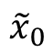
Periodic Orbits & Families
How do we find families of periodic orbits?
The Family Finding Algorithm of course!
y
$${\tilde{x}}_{0}$$
x

Slide 3
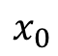
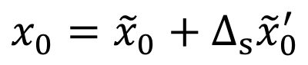
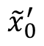
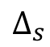
Periodic Orbits & Families
How do we find families of periodic orbits?
The Family Finding Algorithm of course!
y
$${\tilde{x}}_{0}^{′}$$
$$x_{0}={\tilde{x}}_{0}+Δ_{s}{\tilde{x}}_{0}^{′}$$
$$Δ_{s}$$
$$x_{0}$$
$${\tilde{x}}_{0}$$
x

Slide 4
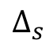
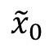
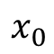
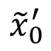
Periodic Orbits & Families
How do we find families of periodic orbits?
The Family Finding Algorithm of course!
y
$${\tilde{x}}_{0}^{′}$$
$$Δ_{s}$$
$$x_{0}={\tilde{x}}_{0}+Δ_{s}{\tilde{x}}_{0}^{′}$$
$$x_{0}$$
$${\tilde{x}}_{0}$$
x

Slide 5
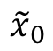
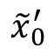
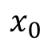
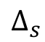
Periodic Orbits & Families
How do we find families of periodic orbits?
The Family Finding Algorithm of course!
y
$$x_{0}$$
$${\tilde{x}}_{0}^{′}$$
$$Δ_{s}$$
$$x_{0}={\tilde{x}}_{0}+Δ_{s}{\tilde{x}}_{0}^{′}$$
$${\tilde{x}}_{0}$$
x

Slide 6
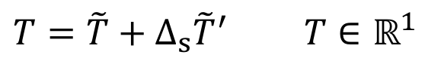
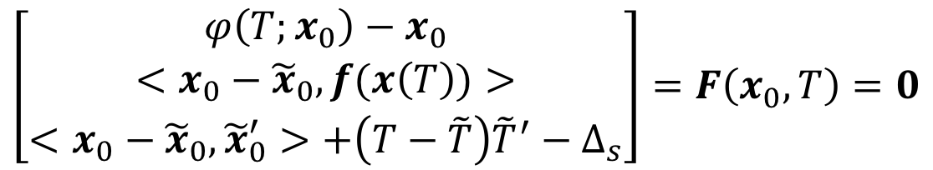
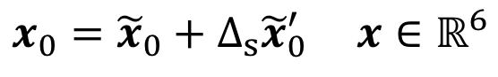
Periodic Orbits & Families
It gets a bit more complicated for periodic orbits.
Correction method uses a single shooter algorithm that solves the follow system of equations.
$$x_{0}={\tilde{x}}_{0}+Δ_{s}{\tilde{x}}_{0}^{′} x∈ℝ^{6}$$
$$T=\tilde{T}+Δ_{s}{\tilde{T}}^{′} T∈ℝ^{1}$$
Definition of periodic orbit
$$\left[\begin{matrix}φ\left(T;x_{0}\right)−x_{0} \\ <x_{0}−{\tilde{x}}_{0}, f(x\left(T\right))> \\ <x_{0}−{\tilde{x}}_{0},{\tilde{x}}_{0}^{′}>+\left(T−\tilde{T}\right){\tilde{T}}^{′}−Δ_{s}\end{matrix}\right]=F\left(x_{0},T\right)=0$$
Poincaré phase constraint
Pseudo-arclength continuation
Notes:
Poincare phase constraint lets us hone in on a single IC point of the infinitely many on the PO
Pseudo-arclength let us hone in on a single periodic orbit from the infinitely many in the family

Slide 7
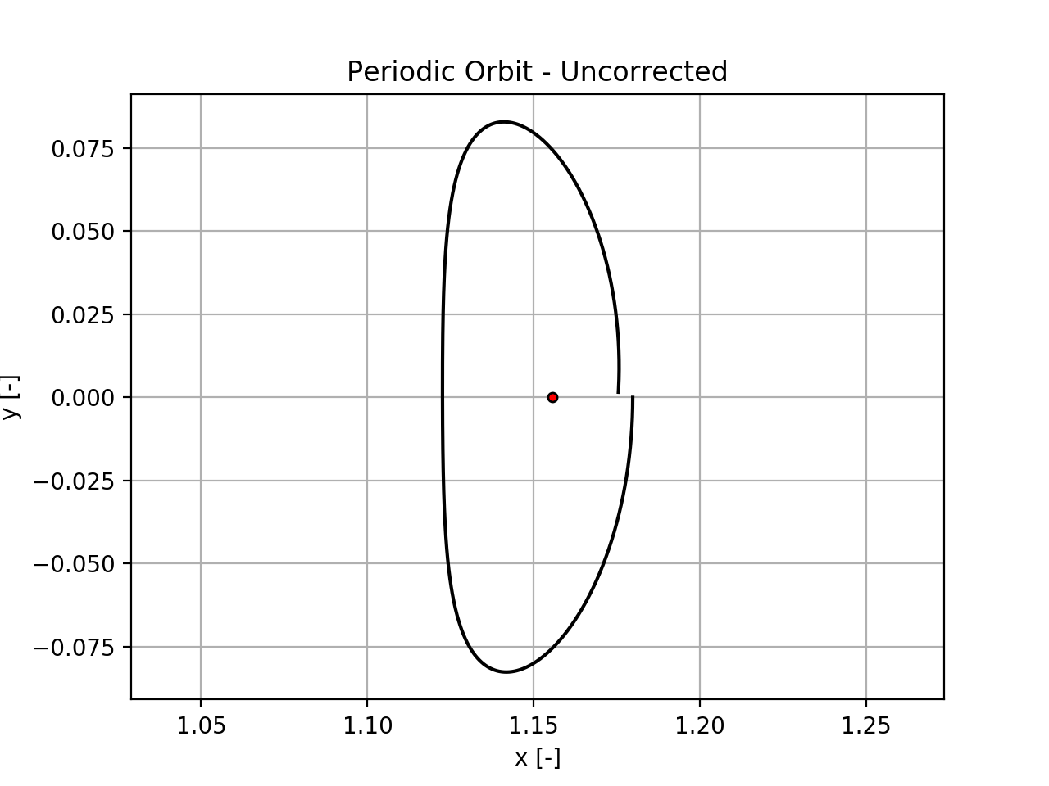
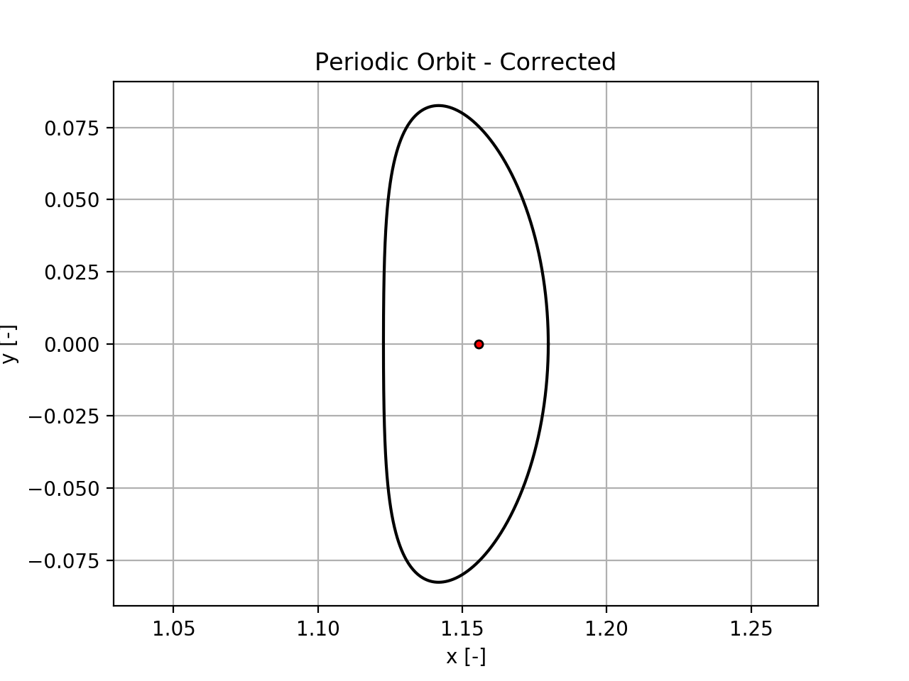
Periodic Orbits & Families

Slide 8
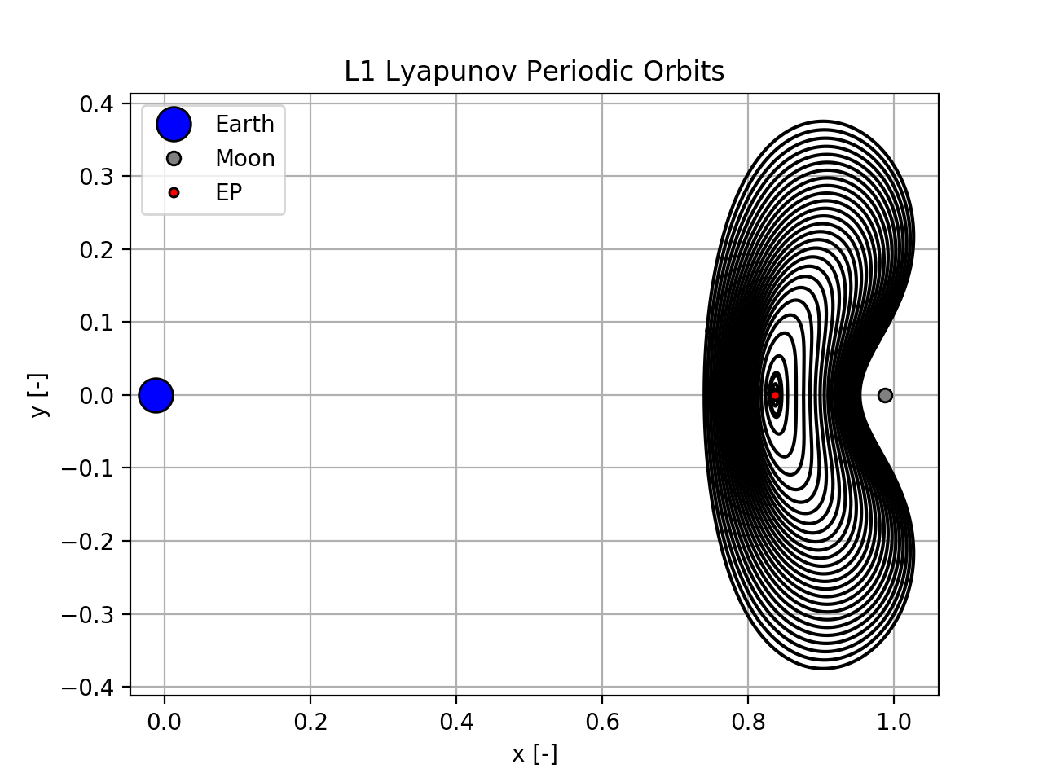
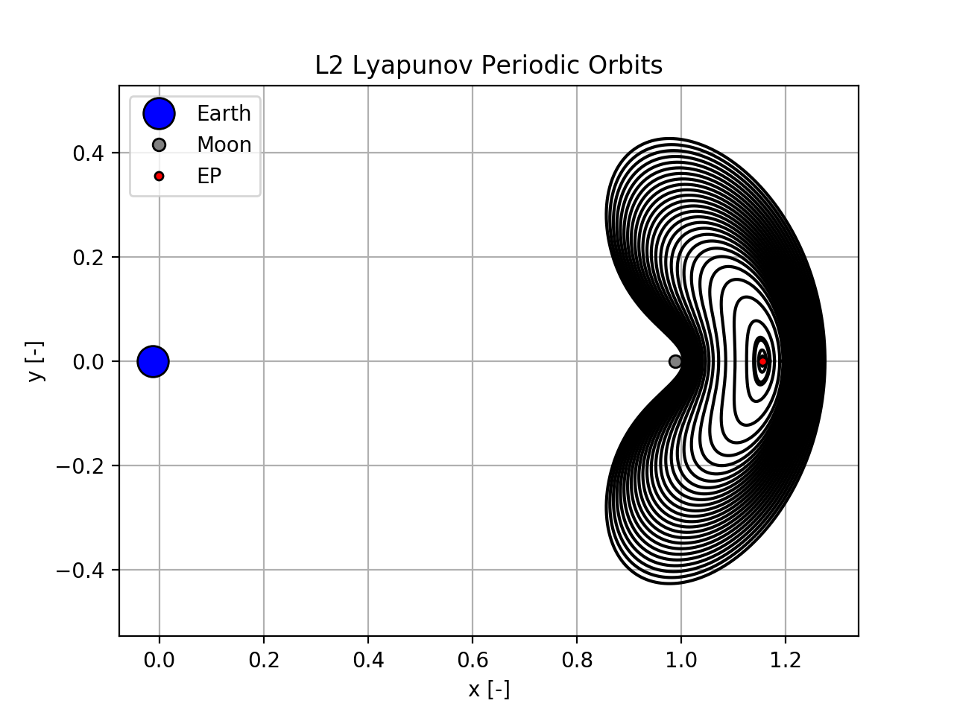
Periodic Orbits & Families

Slide 9
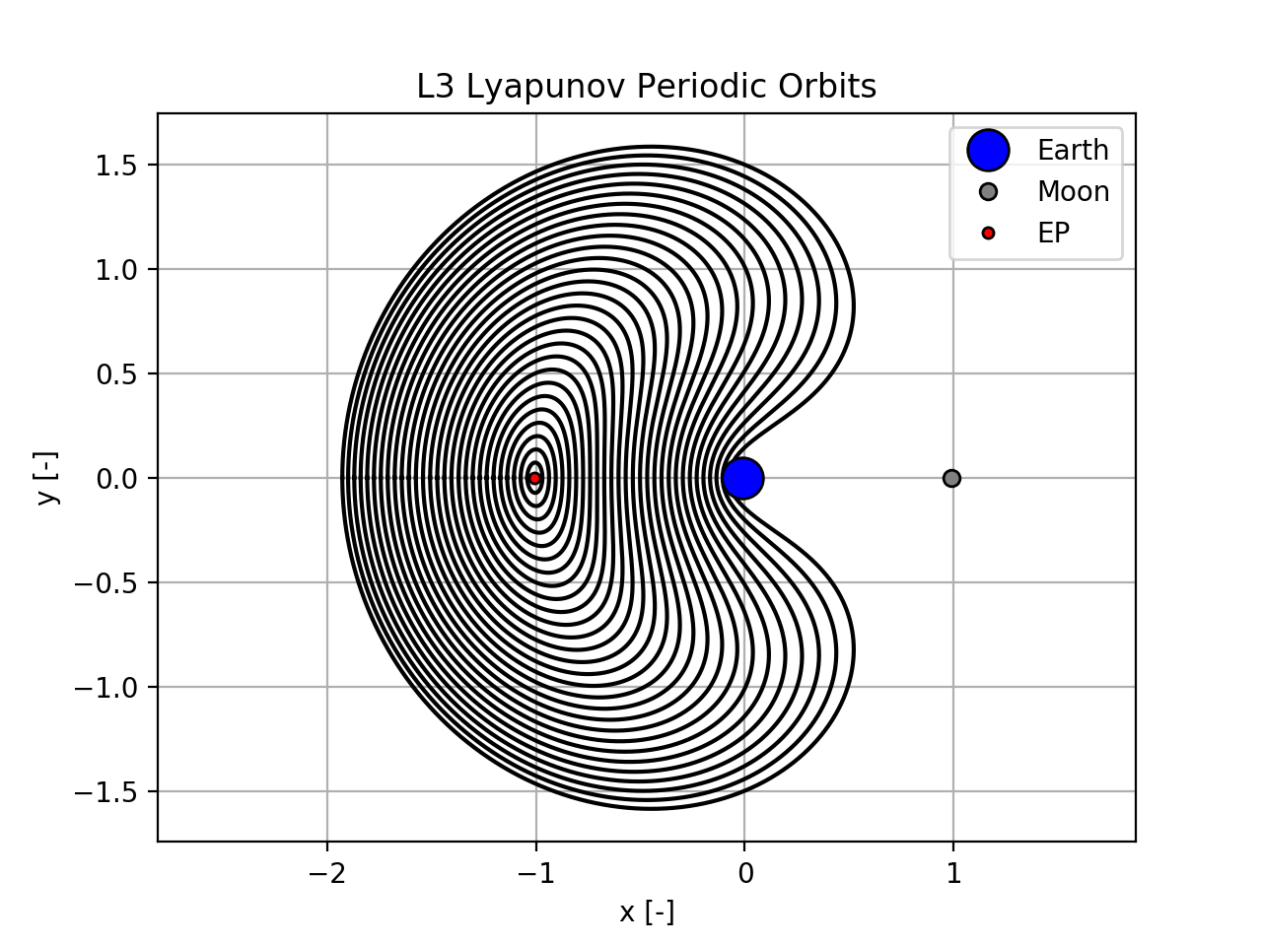
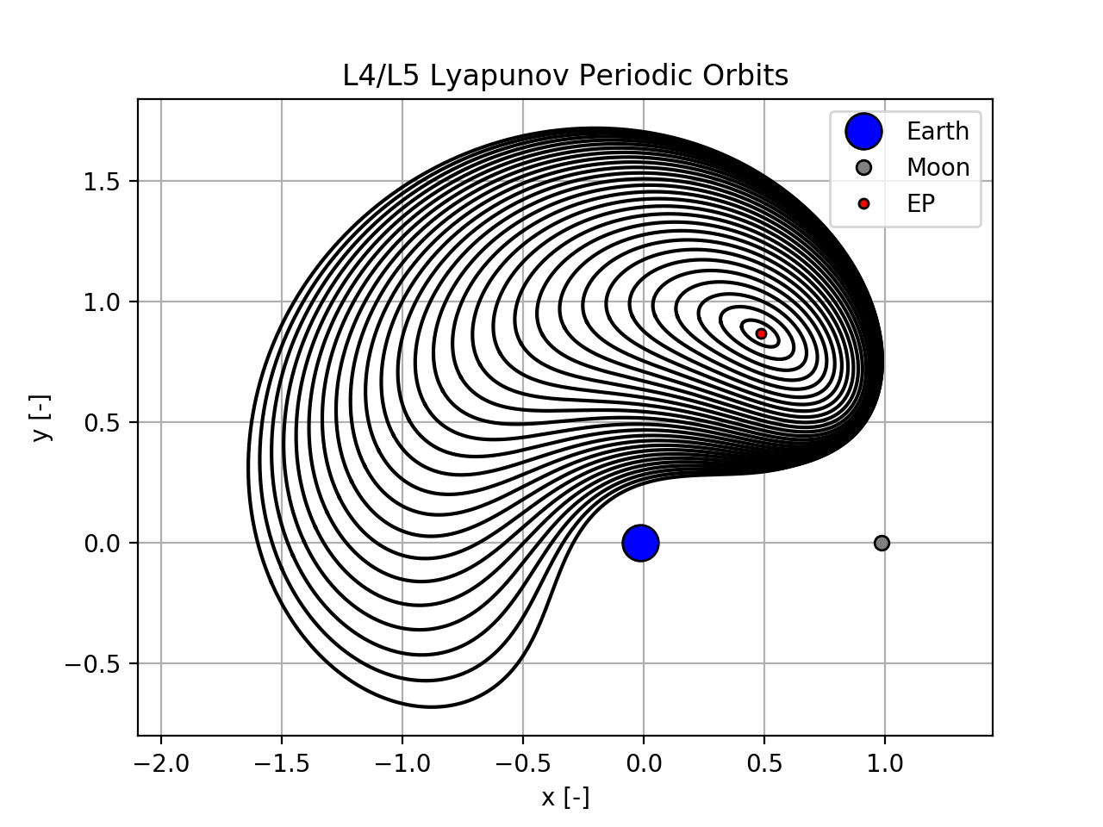
Periodic Orbits & Families

Slide 10
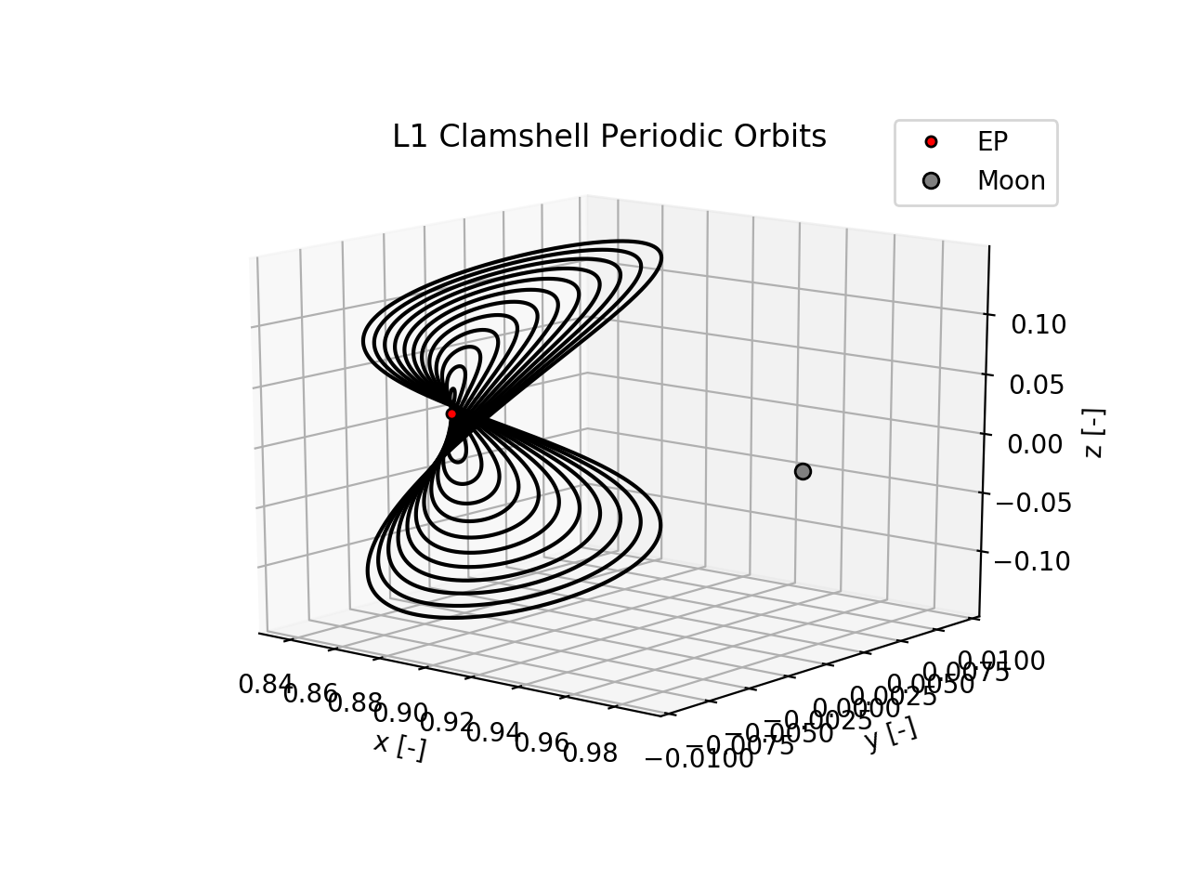
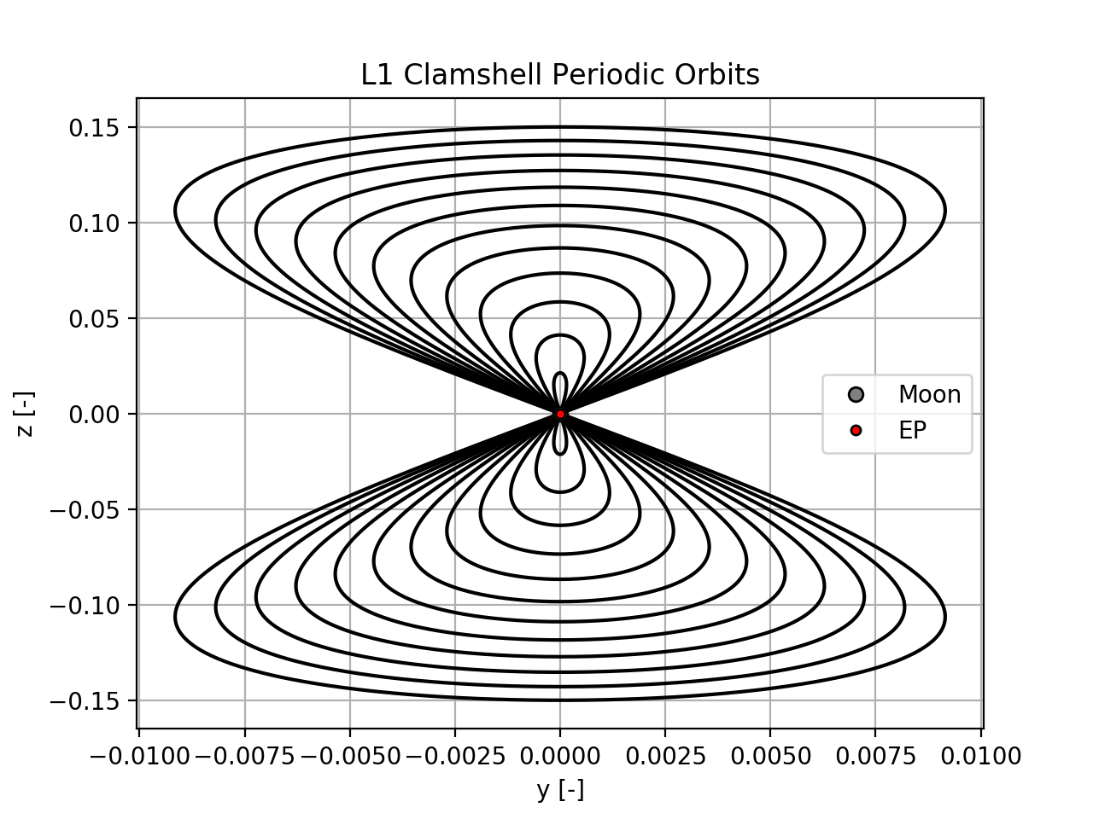
Periodic Orbits & Families

Slide 11
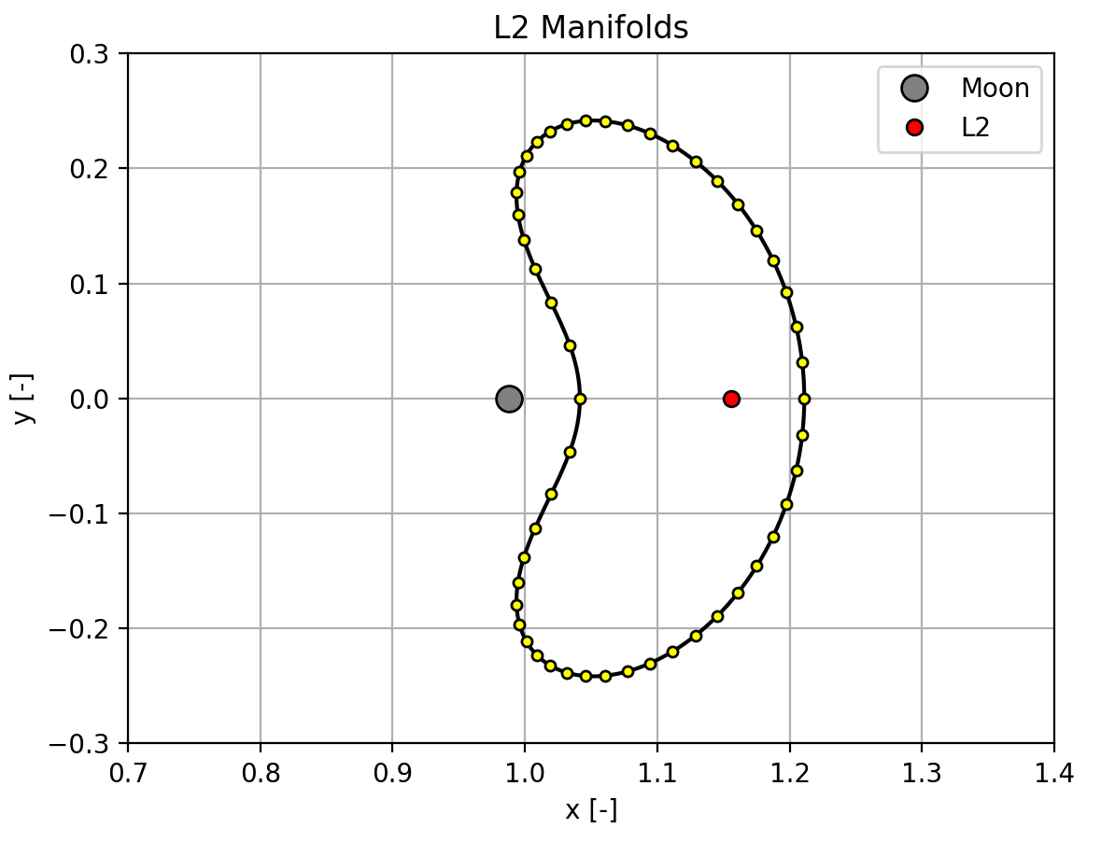
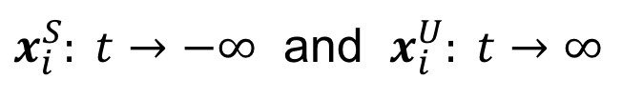
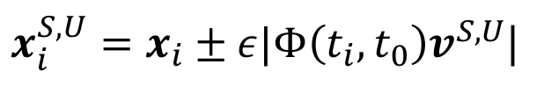
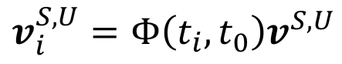
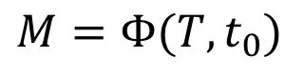
Periodic Orbit Stability & Manifolds
The stability of periodic orbits is determined from the Monodromy matrix.
$$M=Φ(T,t_{0})$$
$$v_{i}^{S,U}=Φ\left(t_{i},t_{0}\right)v^{S,U}$$
$x_{i}^{S,U}=x_{i}±ε|Φ\left(t_{i},t_{0}\right)v^{S,U}$|
$x_{i}^{S}: t→−∞$ and $x_{i}^{U}: t→∞$
Notes:
Discussion of how discretizing and nudging the PO in the stable/unstable direction then propagating backwards/forwards in time reveals manifolds

Slide 12
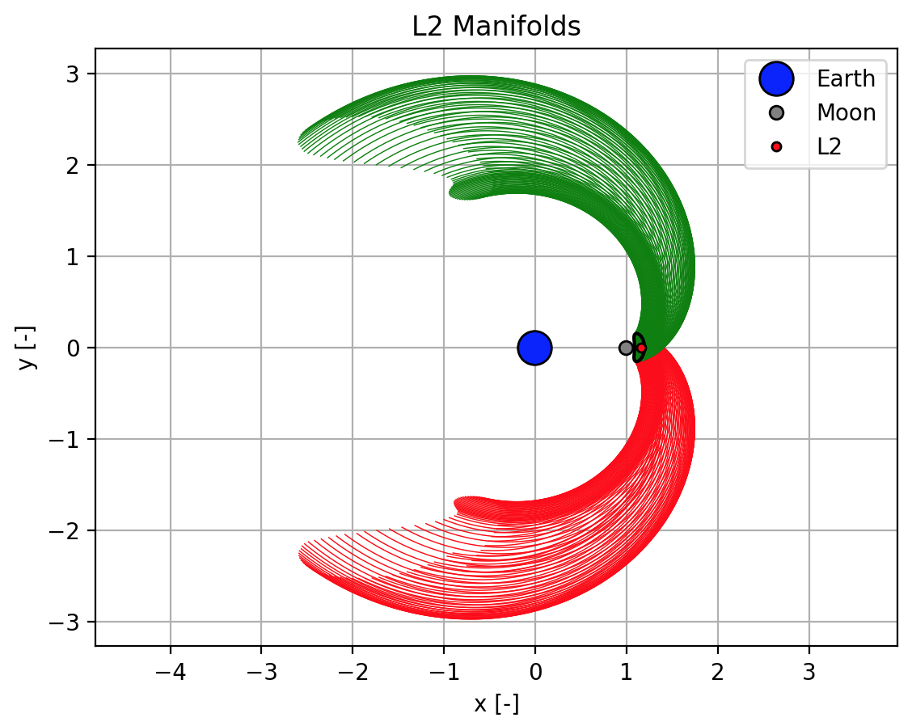
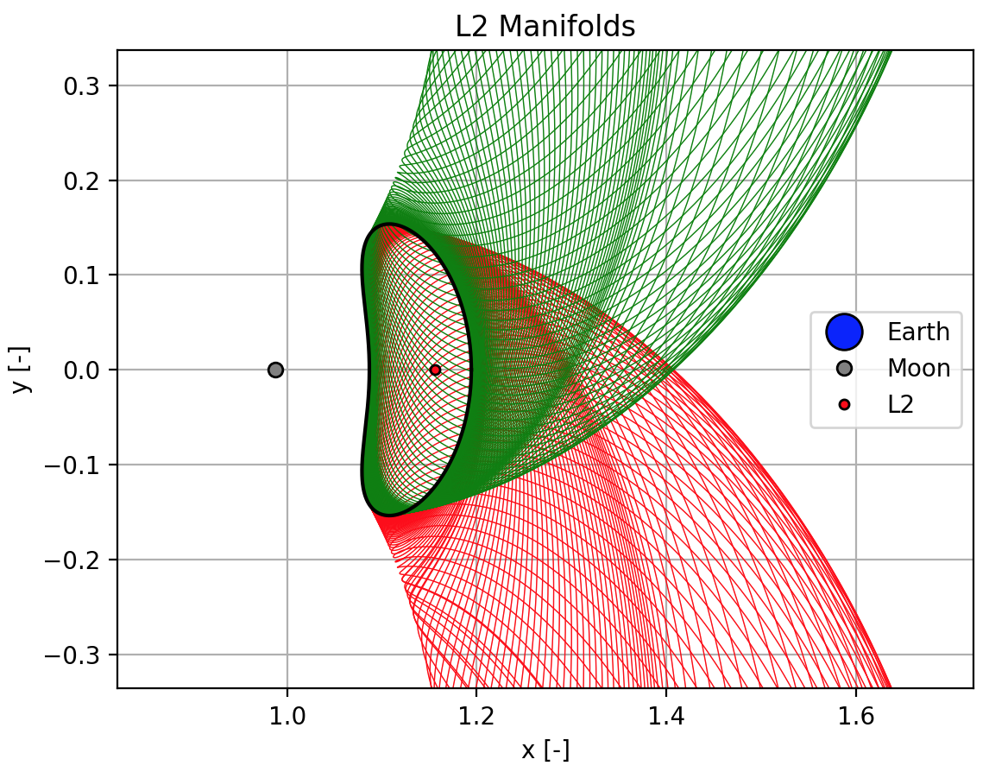
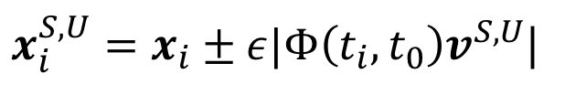
Periodic Orbit Stability & Manifolds
$x_{i}^{S,U}=x_{i}±ε|Φ\left(t_{i},t_{0}\right)v^{S,U}$|
Notes:
Here are the exterior stable and unstable manifolds for a periodic orbit about the L2 Lagrange point.
Each P.O. has interior and exterior stable and unstable manifolds.

Slide 13
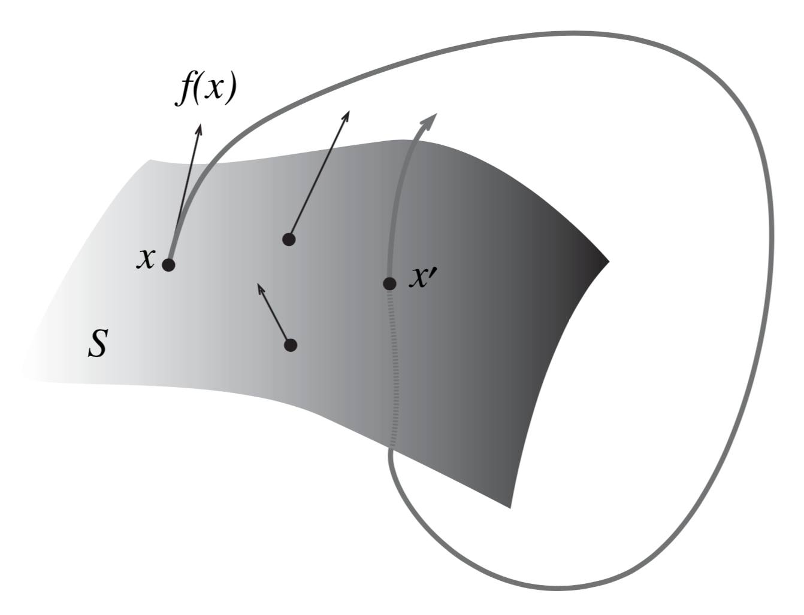
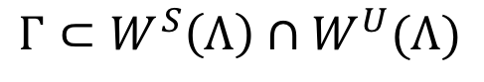
Poincaré Sections & Homoclinic Orbits
Homoclinic orbits occur at the intersection of the stable and unstable manifolds.
In order to find intersections, we use a Poincaré section.
$$Γ⊂W^{S}\left(Λ\right)∩W^{U}(Λ)$$

Slide 14
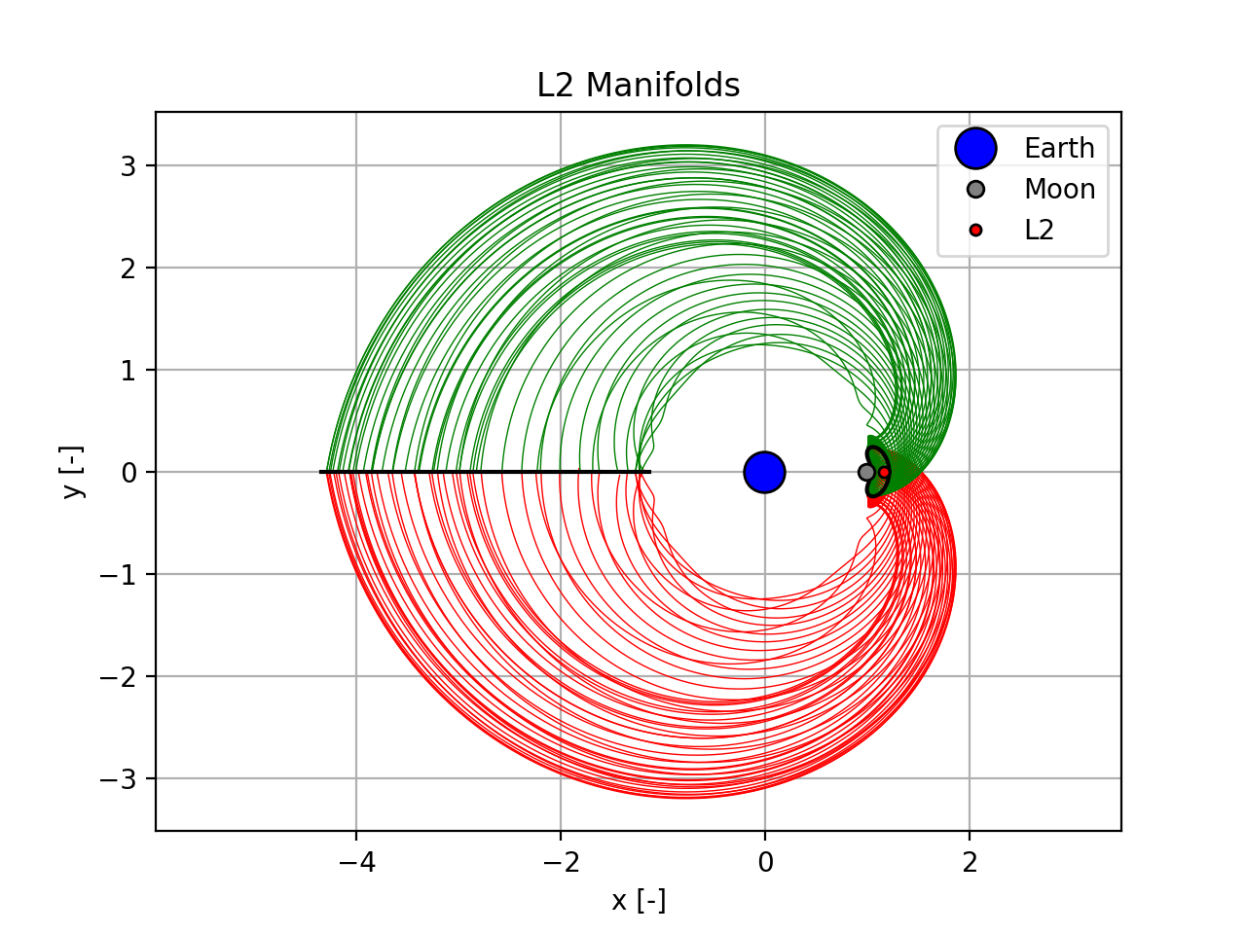
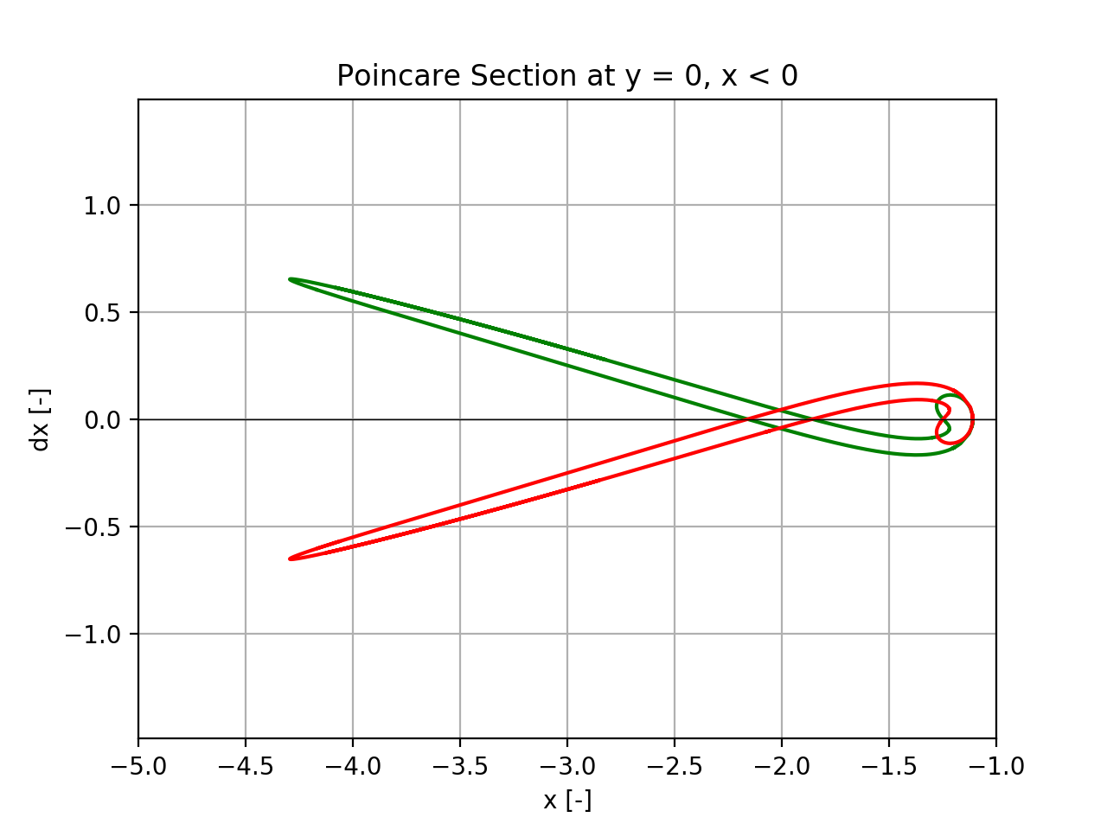
Poincaré Sections & Homoclinic Orbits
A common Poincaré section is y = 0, x < 0 for the exterior L₂ manifolds.

Slide 15
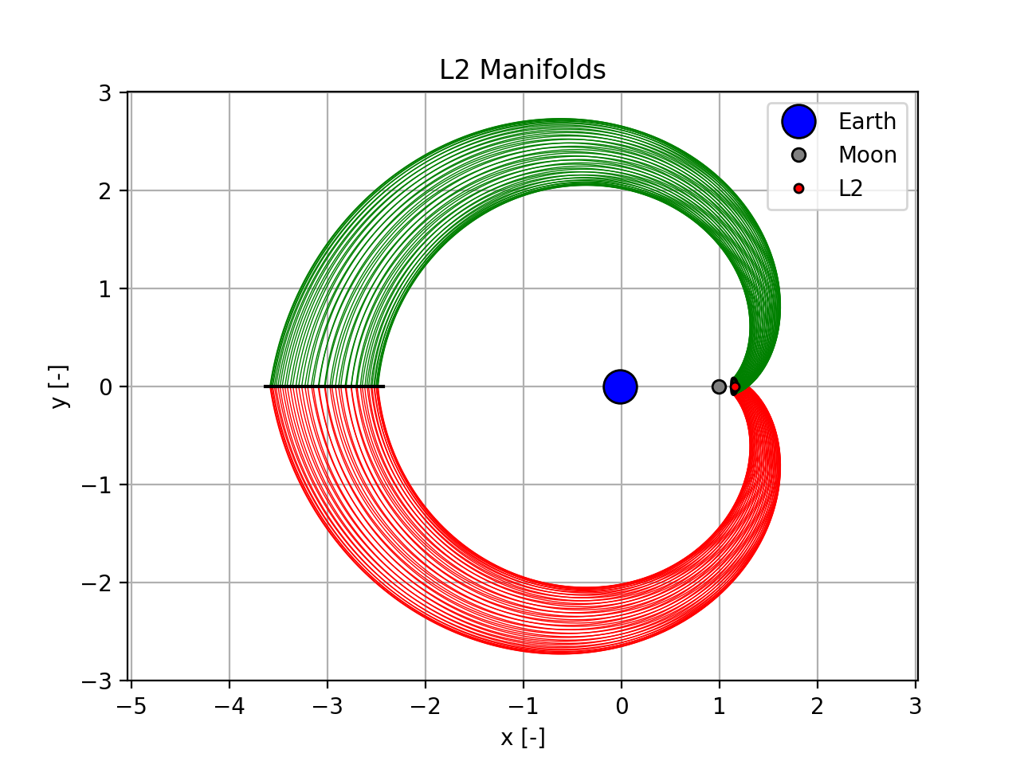
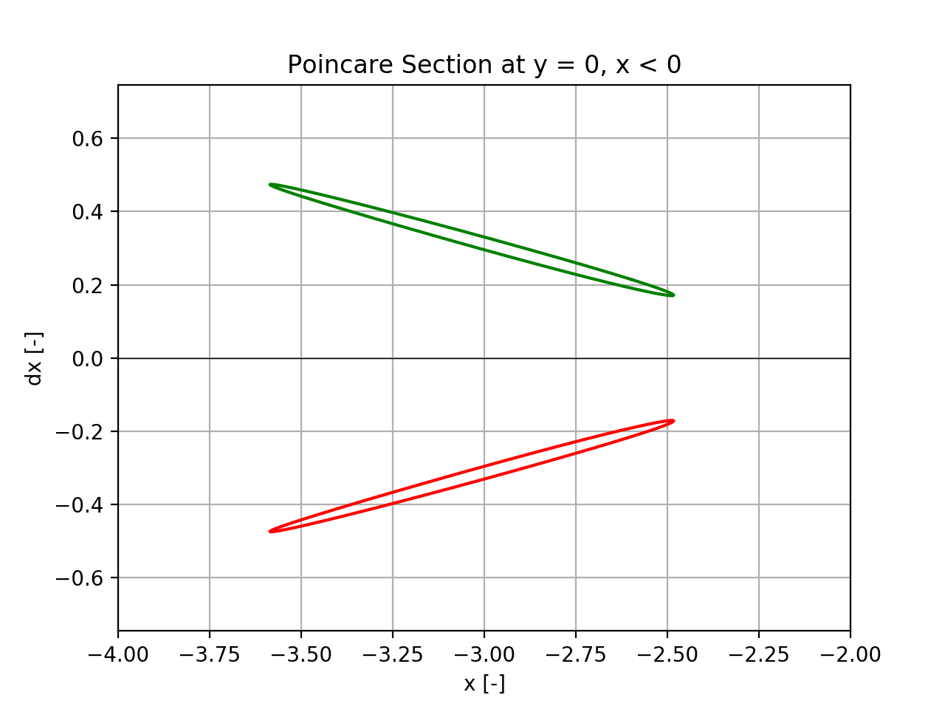
Poincaré Sections & Homoclinic Orbits
Not every periodic orbit has homoclinic orbits!

Slide 16
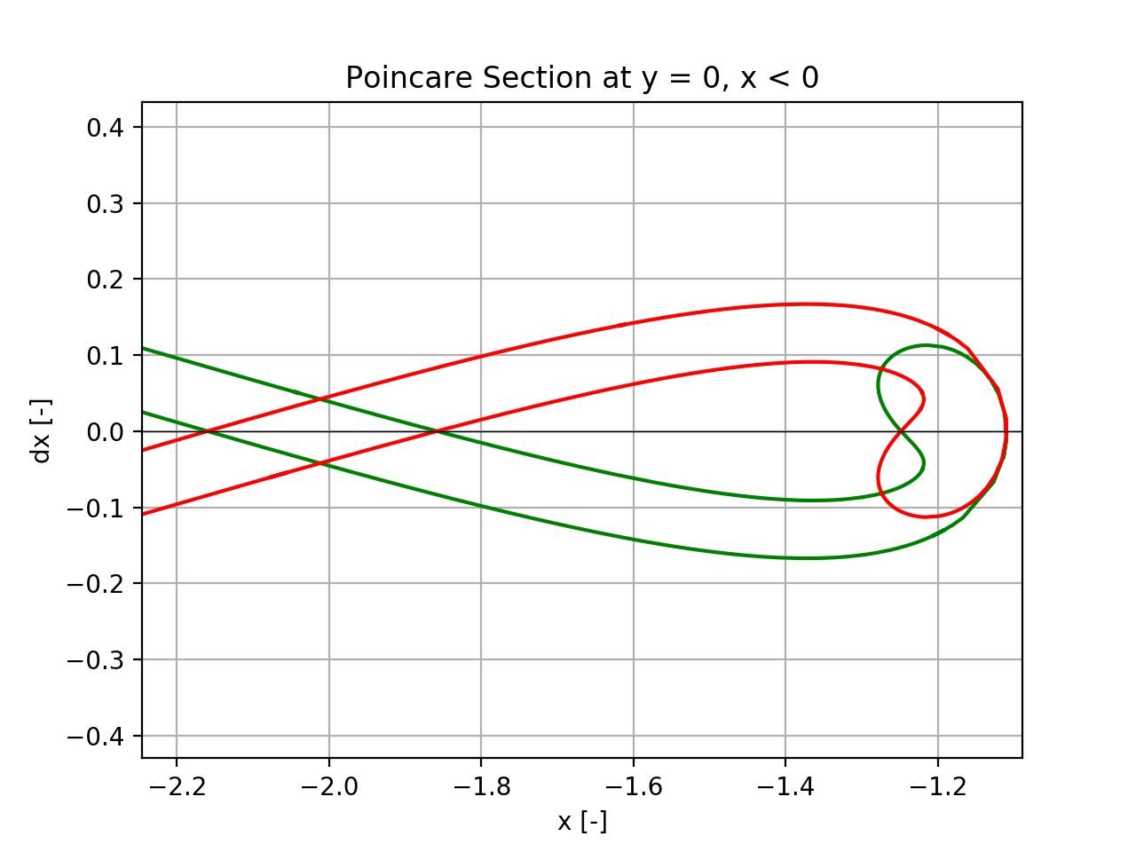
Poincaré Sections & Homoclinic Orbits
Intersection of the stable and unstable manifolds on the Poincaré section correspond to homoclinic orbits.
Notes:
Line dx = 0 are symmetric homoclinic orbits
Other are asymmetric orbits

Slide 17
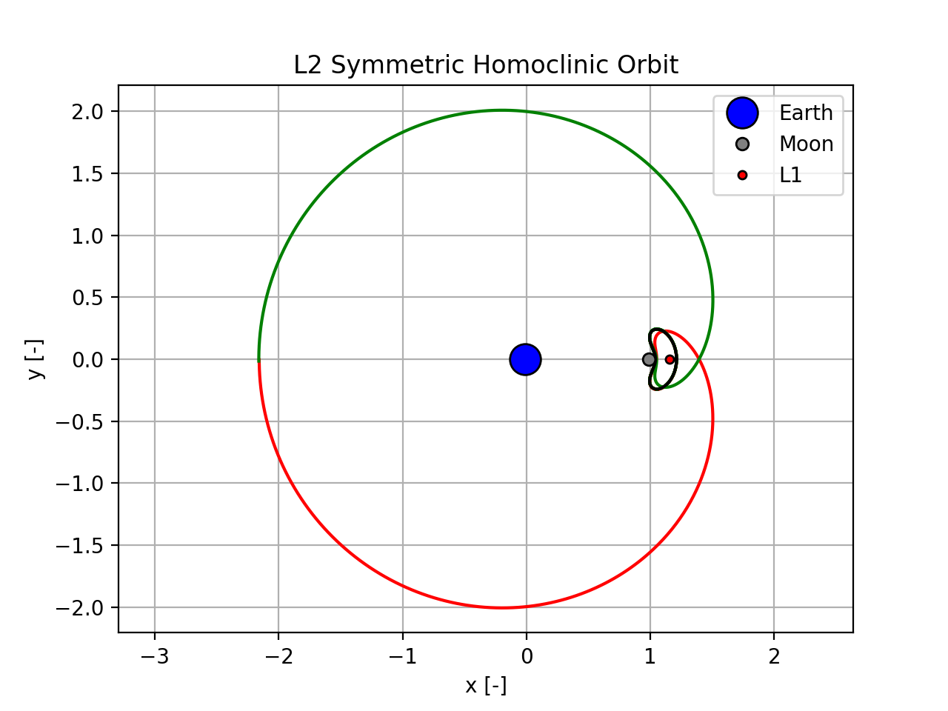
Poincaré Sections & Homoclinic Orbits

Slide 18
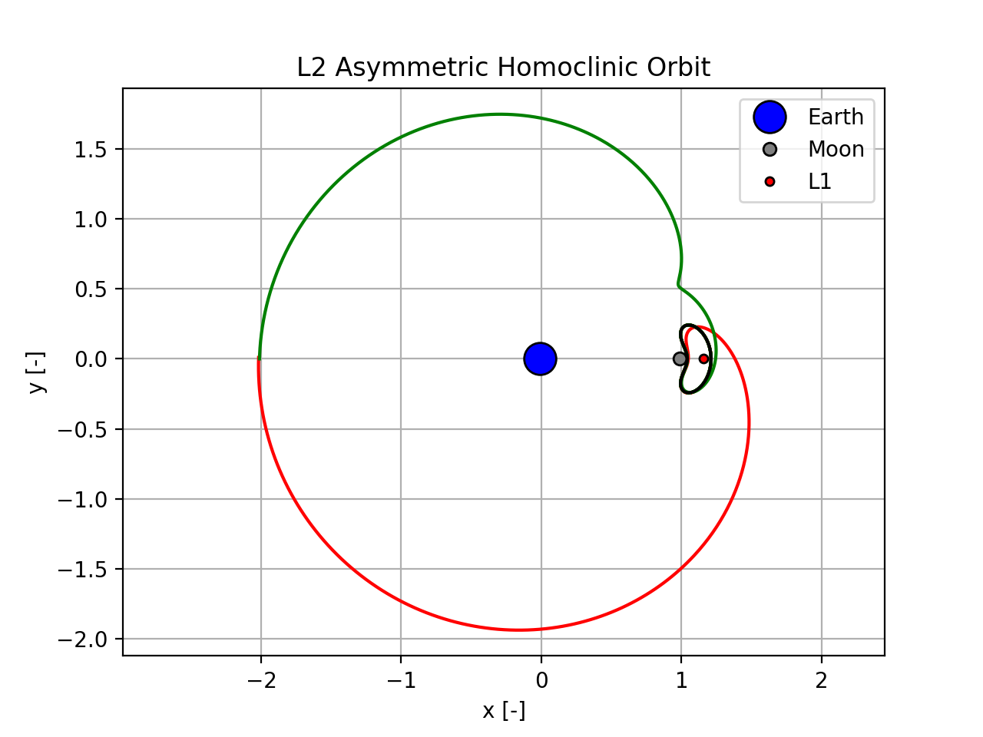
Poincaré Sections & Homoclinic Orbits

Slide 19
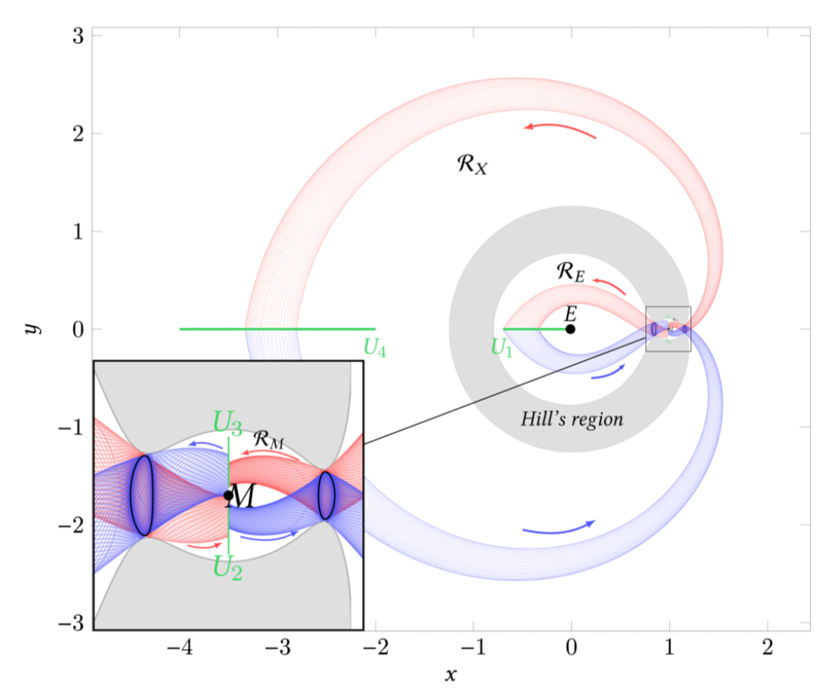
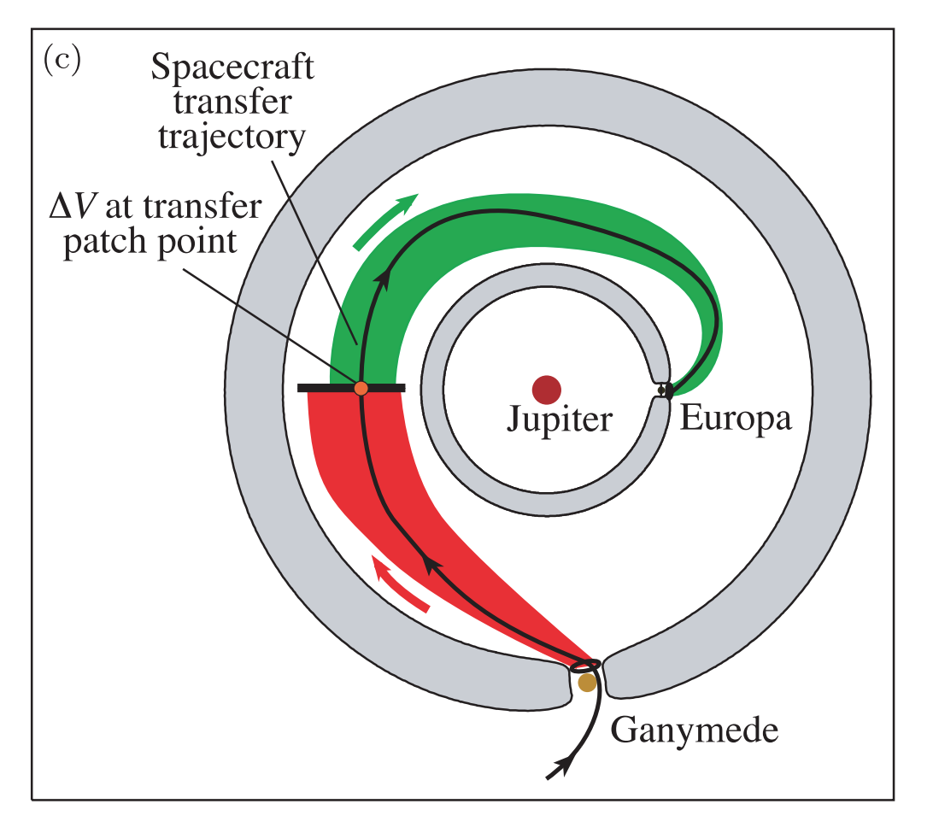
Significance and Usefulness of Homoclinic Orbits
Understand the flow of dynamic systems
For mission design, heteroclinic are generally more valuable
Notes:
-Homoclinic orbits can help understand flow of dynamic system, but for mission design, heterclinic orbits are of much greater use (moon transfers, etc)
-Can cite some papers

Slide 20
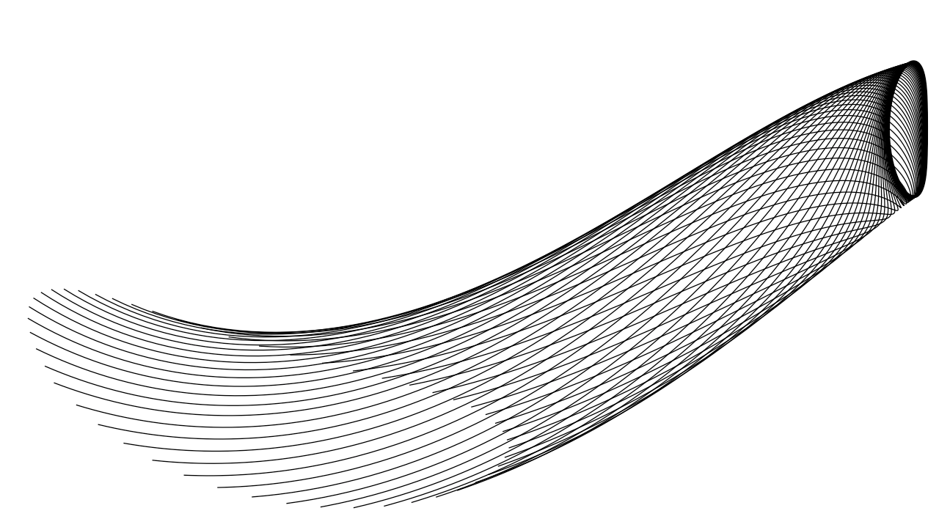
Questions?

Slide 21
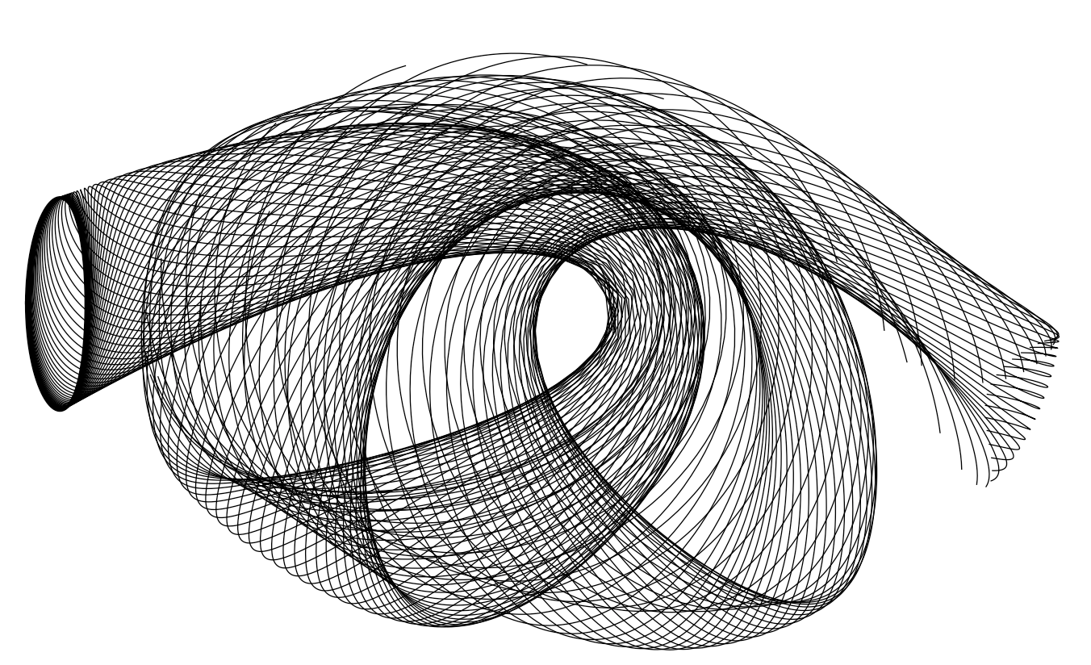
Questions?

Slide 22
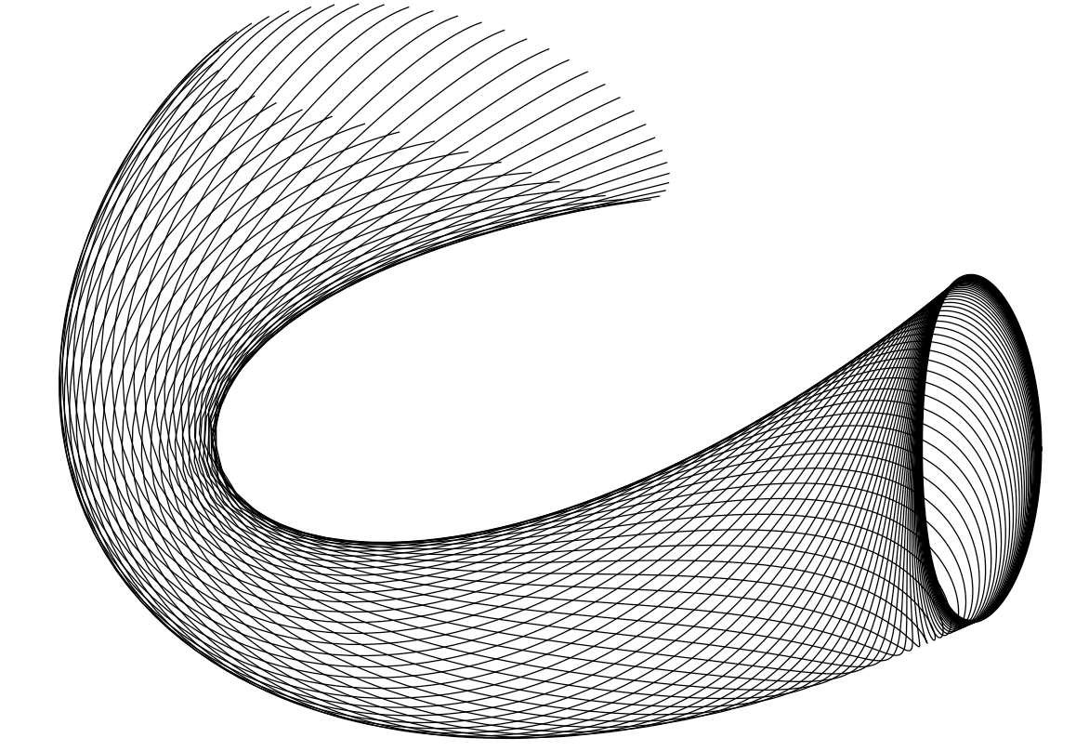
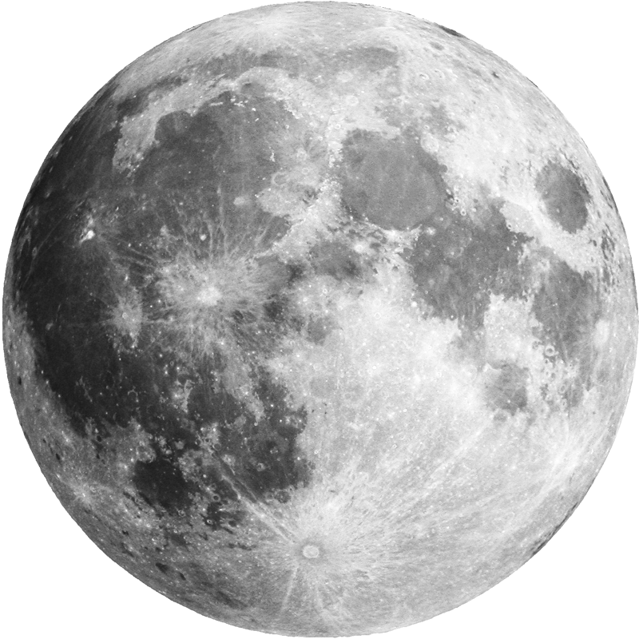
Questions

Slide 23
Extra Slides

Slide 24
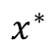
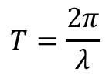
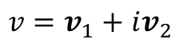


Starting FFA
Lyapunov Center Theorem
Use eigenvalue and eigenvectors of center manifold of Df*
$$εv_{1}$$
$$v=v_{1}+iv_{2}$$
$$T=\frac{2π}{λ}$$
$$x^{∗}$$
$$εv_{2}$$

Slide 25
References
https://en.wikipedia.org/wiki/Henri_Poincare

